Slide 1
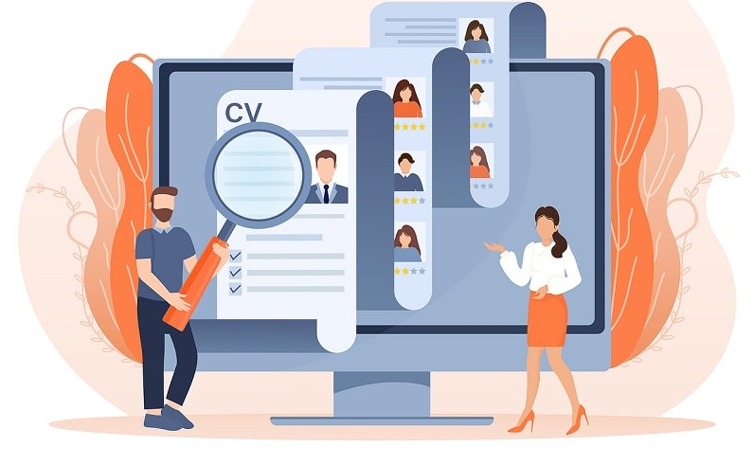
AI Resume Screening & Talent Match System
Project Overview
Workflow
Resume & JD
Skill Extraction (LLM)
AI-powered resume screening
RAG-based job matching
Explainable match scoring
Intelligent hiring recommendation
Embedding + Vector DB
RAG Matching
AI Score & Dashboard
30-Day Plan
Team 2 -
Members:
Nighitha & Farzana
Team Details
Week 1 – Design & Data Week 2 – RAG Development Week 3 – AI Intelligence Week 4 – UI & Testing

